Slide 1
Security Patterns and Practices
Secure Software Development
Wayne Caruana 1BSc2

Slide 2
Cryptography

Slide 3
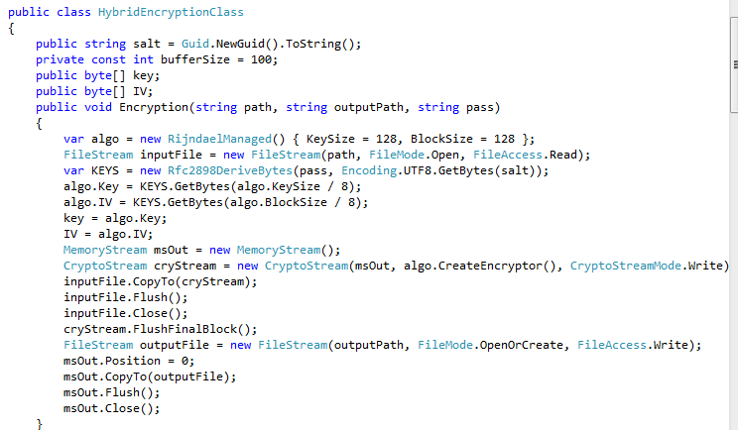
Hybrid Encryption - Steps
Encryption

Slide 4
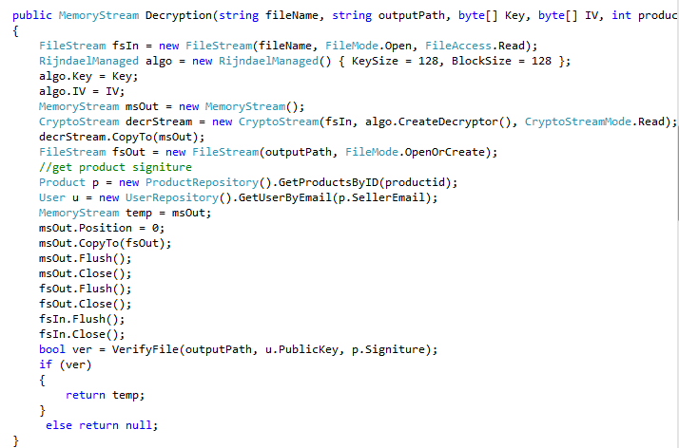
Hybrid Encryption - Steps
Decryption

Slide 5
Hybrid Encryption – Possible Threats
Prevent your system from being hacked in order to steal private data
Prevent you from when an attacker tries to get products without paying for them
By using hybrid encryption the file will be stored encrypted so if anything is stolen it will be un readable.
Apart from hybrid encryption in this section the files is also signed to make sure that nothing was change from when the file was saved at the first place.

Slide 6
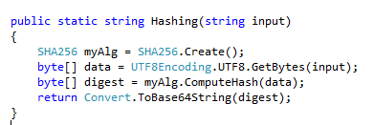
Hashing - Steps

Slide 7
Hashing - Possible Threats
This prevent a hacker from attacking your system and steal valuable data such as:
Passwords (which are very critical in order to access more permissions and access admin tools)
Stealing of files
Since the private key can be encrypted with a safe hashing algorithm this prevent an attacker from stealing such information and have the possibility to steal files and decrypt them.
Keep data safe
Since data will be hashed and therefore unreadable nothing can be done if stolen because it will be unreadable.

Slide 8
User management and authorization

Slide 9
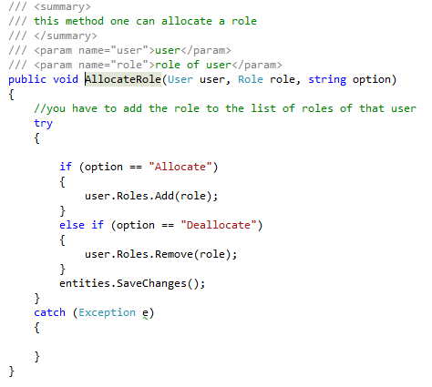
Role Management - Steps

Slide 10
Role Management - Possible Threats
This prevents you from an attacker when trying to access a page without logging in.
Some other mitigations that might be considered here are:
URL Rewriting – This will prevent an attacker to see any sensitive information such as different id’s that might be valuable for an attacker.

Slide 11
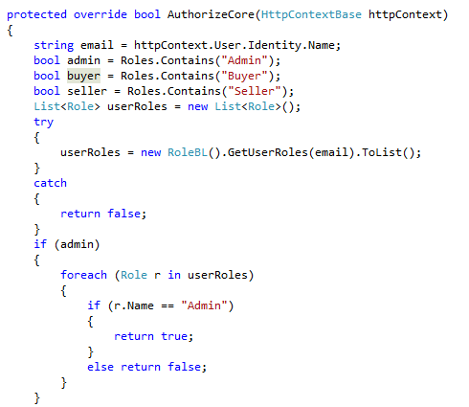
Authorize - Steps

Slide 12
Authorize - Possible Threats
Keep data safe
Authorize to allow a user to only access certain methods
In this case Custom Authorization was used in order to be able to change user permissions at run time.
This will reflect back on the website in real time.
Ex. If an admin adds a permission to a particular user he can start using it right away.

Slide 13
Authentication

Slide 14
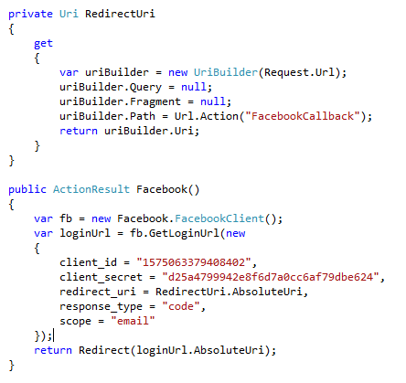
Facebook Login - Steps

Slide 15
Facebook Login - Possible Threats
One of the possible threats that every website has is that of proper authentication
An Attacker can steal sensitive information such as a username and a password in order to access a website as another user.
By using Facebook API you are making sure that proper authentication will take place since:
It is very secure
Allows you to not store any passwords

